Slide 1
INTER-AMERICAN DRUG ABUSE
CONTROL COMMISSION
C I C A D
Secretariat for Multidimensional Security
SEVENTIETH REGULAR CICAD SESSION
November 16th-19th, 2021
Virtual Session
OEA/Ser.L/ XIV.2.70
CICAD/doc.2645/21
November 19, 2021
Textual
CHIEF PROBATION OFFICER SINTRA MAHARAJ
PLENARY SESSION 7, PANEL 8 PRACTICES IN SOCIAL INTEGRATION – CASE CARE MANAGEMENT IN TRINIDAD AND TOBAGO

Slide 2
PRACTICES IN SOCIAL INTEGRATION – CASE CARE MANAGEMENT IN TRINIDAD AND TOBAGO

Slide 3
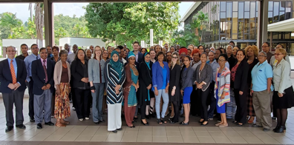
TRINIDAD AND TOBAGO’S INTRODUCTION TO CASE CARE MANAGEMENT
April 2019 - CICAD engaged Trinidad and Tobago (T&T) in the first developmental meeting.
January 2020 - Offered T&T the opportunity to be first to be trained in the completed curriculum.
January 27-30th, 2020 - Training scheduled and undertaken.
Fifty-Nine (59) participants from Eighteen (18) Government and Non-Governmental agencies, working in all areas critical to supporting reintegration efforts for clients.

Slide 4
BENEFITS TO TRINIDAD AND TOBAGO
The Probation Services Division identified as the most appropriate agency due to their role:
Serve as social intervention workers to the Courts of Trinidad and Tobago – Rehabilitation, Provision of social history reports in both criminal and family matters to assist the Court in determining sentences.
The Case Care Management programme will enhance the existing coordination and integration systems at the Division and assist in more timely and efficient delivery of services.
The CCM project in Trinidad and Tobago is situated within the following Legislative and Policy structure:
Probation of Offenders Act, Chapter 13:51 (as amended),
Community Service Orders Act 13:06 (as amended),
Non-Profit Organizations Act, and
Trinidad and Tobago’s National Drug Policy 2021 and National Operational Plan for Drug Control 2021-2025.
Additionally, there are no new implementation costs, as existing resources will be utilized.

Slide 5
ACTIONS TAKEN AFTER JANUARY 2020
Policy level approvals and endorsements - Cabinet of Ministers and the Minister of National Security:
Identification of the Multi-Sectoral Oversight Team – August 2020.
CICAD / Ministry of National Security
Technical Assistance.
Refresher Training – September to November 2020 – seven sessions facilitated by local and international presenters.
Presentation by CCM team to the Chief Justice of Trinidad and Tobago and a judicial team.
Engagement of a Consultant for two deliverables- Mapping Report and Operational Manual.
Convening of a Core Group and a Working Group to guide implementation.
Training for 56 Probation Officers/Community Service Officers.
Sensitization Sessions for key stakeholders and mentors.

Slide 6
VIRTUAL TECHNICAL ASSISTANCE EVENTS

Slide 7
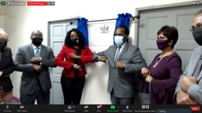
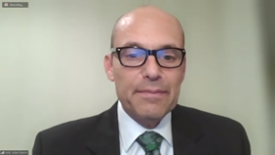
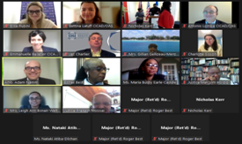
CCM PILOT PROJECT LAUNCH - TRINIDAD AND TOBAGO - 22 SEPTEMBER 2021
A Hybrid Event
In Person – Minister of National Security
Minister of Social Development and Family Services
Charge de Affaires, United States Embassy Port of Spain
Representative of the OAS office Port of Spain
Virtually – Ambassador Adam Namm
Mr. Antonio Lomba
The Institutional Strengthening Team- ES-CICAD
The INL Team from the Department of State
Stakeholders from local and International organizations
and other specially invited guests.

Slide 8
ACTIVITIES FOLLOWING THE LAUNCH
Identification and Mobilisation of the CCM Team.
Selection of suitable participants.
Recruitment and training of mentors.
Ongoing development of two databases – Client and Service Resources.
Decision that on finalization and evaluation of the Pilot Project, CCM will be used for all clients of the Probation Services Division.

Slide 9
THANK YOU
Contact Information:
Sintra Maharaj
Chief Probation Officer
1-868-769-8715
dsmaharaj@mns.gov.tt
Probation Services Division
3rd Floor ANSA House
Corner Queen and Henry Streets
Port of Spain
Republic of Trinidad and Tobago

